Slide 1
CSCI-P 532 Object Oriented Software Development
Assignment 3: Implementation of the Composite Pattern
Ethan Behar,
Christian Dummer,
Raghunadham Gattu,
Saurabh Gulati
Luddy School of Informatics, Computing, and Engineering
INDIANA UNIVERSITY BLOOMINGTON
Notes:
The main goal of my thesis is to find the applicability of high performance computing principles and algorithms in modern end to end deep learning solutions.
With adoptation of deep learning in many areas it is important to have highy efficient frameworks that handle both data processing and deep learning

Slide 2
Demo
To Eclipse!
Notes:
Performance for both data processing and deep learning
ease of use is as important as performance if any framework is to be adopted by the community

Slide 3
Previous Architecture
Our starting codebase consistent of the strengths of Group1 Week2’s and Group2 Week2’s codebases.
PausableGameEngine
Implements Observable interface
Implemented using AnimationTimer (previously was Timeline)
Renderer / ColliderHandler2D
Draws objects to game canvas
Checks and informs objects if collision occurred
KeyPolling (Singleton)
No changes here
DrawObject
Base class for all objects on screen
CommandInvoker (Invoker):
Responsible for gathering one tick’s commands into a MacroCommand
PausableGameEngine (Client/Commander) tells CommandInvoker to when to execute commands
Notes:
Performance for both data processing and deep learning
ease of use is as important as performance if any framework is to be adopted by the community

Slide 4
Architecture: Composite Pattern
SaveLoadManager:
Responsible for handling dialogue/file picking logic and starting RootSavable
Saving: Json string is created from all Savables and written to a file.
Loading: Json string is parsed into a JsonObject and sent down the tree to load information into objects.
RootSavable (CompositeSavable):
The starting point for saving and loading all objects.
Returns finalized Json string to SaveLoadManager for writing.
Receives loaded JsonObject from SaveLoadManager.
Rebuilds references between Commands and DrawObjects
Savable Interface
Composite Savables:
  RootSavable, CommandInvoker, MacroCommand, ObjectPooler
Leaf Savables:
  Commands, DrawObjects
save(), load(), addSavable(), removeSavable()
Notes:
Performance for both data processing and deep learning
ease of use is as important as performance if any framework is to be adopted by the community

Slide 5
Architecture: Composite Pattern
LayoutManager:
Responsible for creating and building Layables
Informs Layables (itself included) to changeLayout() when button is clicked
Layable Interface
Composite Layables:
  LayoutManager, LayablePane, LayableCanvas
Leaf Layable:
  LayableButton
changeLayout(), addLayable(), removeLayable()
Notes:
Performance for both data processing and deep learning
ease of use is as important as performance if any framework is to be adopted by the community

Slide 6
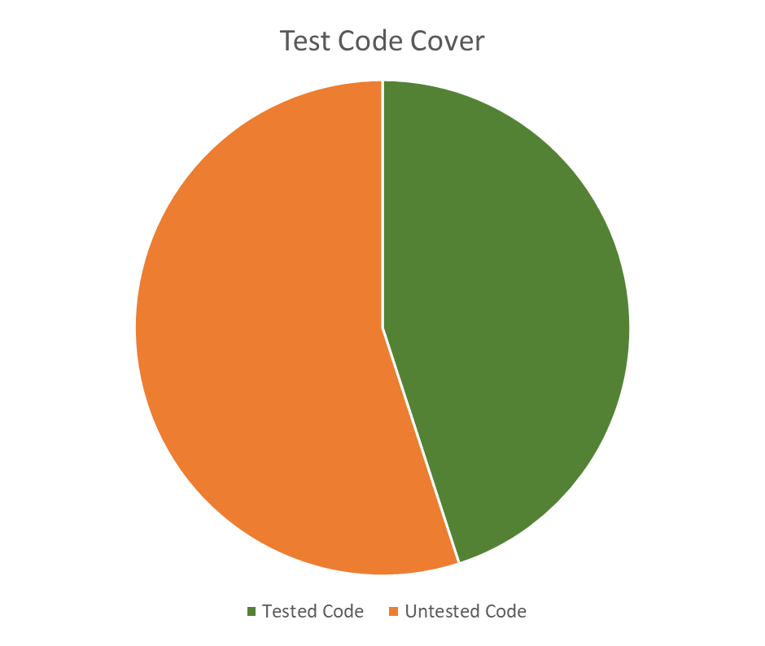
JUnit/EclEmma Summary
Notes:
Performance for both data processing and deep learning
ease of use is as important as performance if any framework is to be adopted by the community

Slide 7
Teamwork
Team meeting Monday after class
  Assigned tasks
    Save/Load – Ethan
    Layout – Christian and Saurabh
    JUnit/EclEmma - Ragu
  Determined codebase to build of off
  Agreed to only conceptualized how to do this and not implement code
  until after Wednesday
Coming together
  Good communication in regards to helping each other when we were stuck
  Biggest roadblock – logical implementation of Composite Pattern
  Over the weekend we pair programmed to combine our various tasks
Notes:
Performance for both data processing and deep learning
ease of use is as important as performance if any framework is to be adopted by the community

Slide 8
Thank you!
Questions?
Comments?
Notes:
Performance for both data processing and deep learning
ease of use is as important as performance if any framework is to be adopted by the community

